Slide 1
Online Furniture Shop

Slide 2
PRESENTATION BY:
NAME: ROLL NO:
Kartik Agrawal A02
Vishwa Patel A52
Rahi Shah A63
GROUP NO:
19

Slide 3
INTRODUCTION TO PROJECT:
“Online Furniture Shop” is a web-based application. The main aim of this project is to established an online furniture shop system which allows the user to buy the furniture online.
As we know in this present generation which has money but lack of time can’t go to the furniture shop to buy furniture. It is time consuming process in this technical world everything we want online.
By Keeping this point in mind, we have developed this online furniture portal.
Now they can obtain their desire furniture without leaving the comfort of their home.
This application helps users to find different type of furniture of different material, look, style at a single place.

Slide 4
Existing System:
In Existing System Furniture shopping can done in manual way, the customer has to go for shopping. It is more time-consuming process.
They must need to go to different shop for different designs.
When customer approach for manual shopping, they do not have an idea about things like price range, items etc.
Reports are prepared manually as and when needed.

Slide 5
Need for the New System:
There is always a need of a system that will perform to purchasing furniture products online according to customer requirement.
It is very much faster than manual system.
Easy to generate report for any transaction.
This system will help to achieve maximum efficiency in shopping online and to reduce the time taken to purchase items.

Slide 6
Objective of the New System:
This Project is aimed at developing a web application that depicts online shopping of furniture.
This application helps customer to find different type of furniture of different material, look and style at a single place.
It is easy to access information.
If the user like Products, they may add it to cart.

Slide 7
Problem Definition:
The existing system is manual system, it needs to be converted into automated system
The customer can also add their needed items to their cart and buy those later on
An administrator will monitor the website activities and manage the product items and manage the cart

Slide 8
Core components:
Admin Login - Admin logins into the system.
Admin – Can manage the product.
User Registration – Users register in the system.
User Login - User’s logins in the system.
User – Can search and view the product.
User – Can add and buy their product in cart.

Slide 9
Project Profile:
Project Title | Online Furniture shop
Front-End | HTML, CSS3, Bootstrap
Back-End | Django 3.1.12, SQLite 3.36.0
Technology | Python 3.7
Project duration | 1 month
Team size | 3
Team Name | 1.Kartik Agrawal 2.Vishwa Patel 3.Rahi Shah
Guided By | Bhavin shah

Slide 10
Assumption and constraints:
Assumptions
User must be trained for basic computer functionalities.
Constraints:
All the inputs should be checked for validation and messages should be given for the improper data.
Details provided by the vendor during his sign up should be stored in database.
While adding the products to the system, mandatory fields must be checked for validation whether the vendor has filled appropriate data in these mandatory fields.

Slide 11
Advantages of the System:
Save time: When it comes to online purchase, you just need to spare few minutes to browse online store, buy one of your choice and get it delivered at your right place by being at the comfort of your home.
Huge variety for selection: The benefit of buying furniture online is that you get sample choice for purchase. You can find different styles, patterns and designs from all top brands and designers at a single store.
No pressure to buy: One of the best benefit of online furniture shopping is that you can shop with peace of mind. No one can be there to force you to buy the particular thing. You will explore the variety of furniture without any pressure of buying anything.
Easy to compare prices of different providers: You can easily compare the price when shopping online. Rather than having to visit several shops to know the price, looking online is a more convenient option.

Slide 12
Limitation of the Proposed System:
Cannot be sure of the quality:
In many cases you can’t be sure of its quality. The color and size in the images on the website will be different from the way they appear. You can’t touch the furniture. only when the furniture is delivered you can see it is about.
Shipping charges:
When you see the product, it generally looks cheaper but when you proceed for payment the extra charges like shipping charge are added. These charges will make the product expensive.
Waiting for delivery:
In online shopping you need to wait more than 4-5 days for product delivery.

Slide 13
Requirement determination:
Functional requirements:
Admin can login and manage the users
Users can register and then login
Users can manage and edit their profile
Admin can add, edit or remove the Products.
User can buy product online.
Non-functional requirements:
Should work efficiently on regular internet connection
Secure database.

Slide 14
Targeted Users:
Admin:
Admin can log in system.
Admin can manage Users.
Admin can manage product
User:
Customer can register and login our system.
Customer can manage his Profile.
Customer can view Products.
Customer can manage his cart with products
Customer can buy products.

Slide 15
System Design

Slide 16
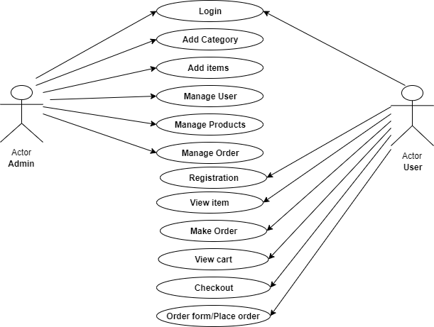
Use case diagram of Admin & User side:

Slide 17
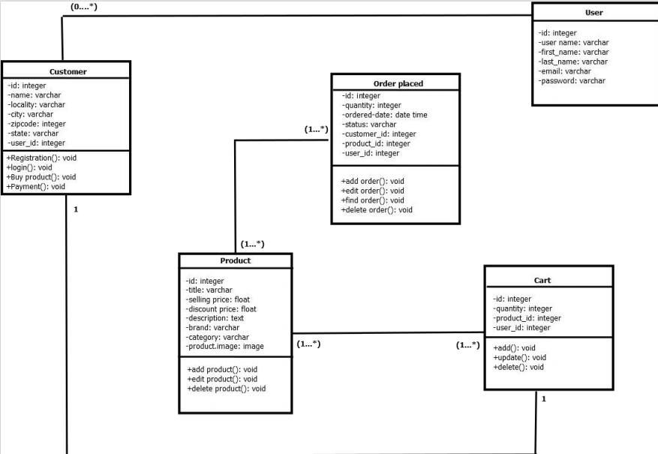
Class diagram:

Slide 18
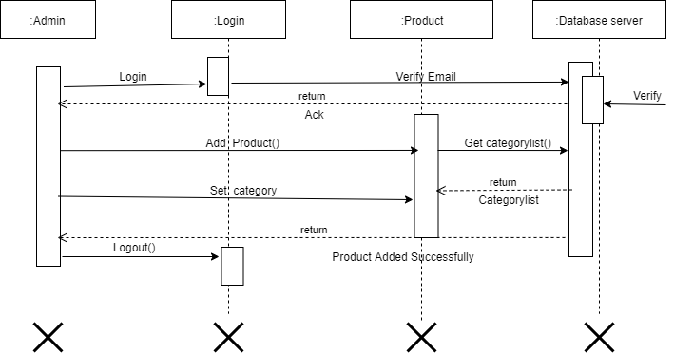
Interaction diagram

Slide 19
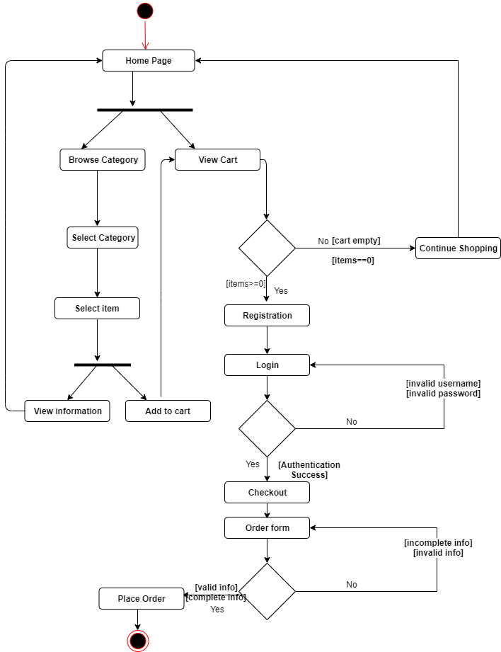
Activity diagram:

Slide 20
Data Dictionary

Slide 21
LIST OF DATA DICTIONARY TABLE:
USER
CUSTOMER
PRODUCT
CART
ORDER PLACED

Slide 22
TABLE NAME: USER DESCRIPTION: Table gives details of users PRIMARY KEY: USER_ID
1.USER
NO | FIELD_NAME | DATA TYPE | CONSTRAINTS | DESCRIPTION
1 | USER_ID | INT | PK | IT CONTAINS UNIQUE VALUE
2 | USER_NAME | VARCHAR (150) | NOT NULL | STORE THE USER NAME
3 | FIRST_NAME | VARCHAR (150) | NOT NULL | STORE THE FIRST NAME
4 | LAST_NAME | VARCHAR (150) | NOT NULL | STORE THE LAST NAME
5 | EMAIL | VARCHAR (150) | UNIQUE | STORE THE EMAIL
6 | PASSWORD | VARCHAR (150) | NOT NULL | STORE THE PASSWORD

Slide 23
TABLE NAME: CUSTOMER DESCRIPTION: Table gives details of customers PRIMARY KEY: CUST_ID FOREIGN KEY: USER_ID
2.CUSTOMER
NO | FIELD_NAME | DATA TYPE | CONSTRAINTS | DESCRIPTION
1 | CUST_ID | INT | PK | IT CONTAINS UNIQUE VALUE
2 | CUST_NAME | VARCHAR (100) | NOT NULL | STORE THE USER NAME
3 | ADDRESS1 | VARCHAR (200) | NOT NULL | STORE THE ADDRESS
4 | ADDRESS2 | VARCHAR (200) | NOT NULL | STORE THE ADDRESS
5 | CITY | VARCHAR (50) | NOT NULL | STORE THE CITY
6 | ZIP CODE | INT | NOT NULL | STORE THE ZIPCODE
7 | STATE | VARCHAR (50) | NOT NULL | STORE THE STATE
8 | USER_ID | INT | FK | STORE THE USER ID

Slide 24
TABLE NAME: PRODUCT DESCRIPTION: Table gives details of products PRIMARY KEY: PRO_ID
3.PRODUCT
NO | FIELD_NAME | DATA TYPE | CONSTRAINTS | DESCRIPTION
1 | PRO_ID | INT | PK | IT CONTAINS UNIQUE VALUE
2 | TITLE | VARCHAR (100) | NOT NULL | STORE THE PRODUCT TITLE
3 | SELLING_PRICE | FLOAT |  | STORE THE SELLING PRICE
4 | DISCOUNT_PRICE | FLOAT |  | STORE THE DISCOUNT PRICE
5 | DESCRIPTION | TEXT | NOT NULL | STORE THE PRODUCT DESCRIPTION
6 | BRAND | VARCHAR (100) | NOT NULL | STORE THE BRAND NAME
7 | CATEGORY | VARCHAR (2) | NOT NULL | STORE THE CATEGORY
8 | PRODUCT_IMAGE | VARCHAR (100) | NOT NULL | STORE THE PRODUCT IMAGE

Slide 25
TABLE NAME: CART DESCRIPTION: Table gives details of cart FOREIGN KEY: USER_ID, PRO_ID
4.CART
NO | FIELD_NAME | DATA TYPE | CONSTRAINTS | DESCRIPTION
1 | ID | INT | NOT NULL | STORE CART ID
2 | USER_ID | INT | FK | REFERENCES TO USER
3 | PRO_ID | INT | FK | REFERENCES TO PRODUCT
4 | QUANTITY | INT | NOT NULL | STORE THE QUANTITY

Slide 26
TABLE NAME: ORDER PLACED DESCRIPTION: Table gives details of order PRIMARY KEY: ORDER_ID FOREIGN KEY: USER_ID, CUST_ID, PRO_ID
5.ORDER PLACED
NO | FIELD_NAME | DATA TYPE | CONSTRAINTS | DESCRIPTION
1 | ORDER_ID | INT | PK | IT CONTAINS UNIQUE VALUE
2 | QUANTITY | INT | NOT NULL | STORE THE QUANTITY
3 | ORDER_DATE | DATETIME | NOT NULL | IT DISPLAY THE DATE OF ORDERED PRODUCT
4 | STATUS | VARCHAR (50) | NOT NULL | STORE THE STATUS
5 | USER_ID | INT | FK | REFERENCES TO USER
6 | CUST_ID | INT | FK | REFERENCES TO CUSTOMER
7 | PRO_ID | INT | FK | REFERENCES TO PRODUCT

Slide 27
Development

Slide 28
Coding Standards:
Naming Convention:
Use meaningful names
Function and variable names in snake_case
Classname in PascalCase
Indentation/Space:
Use 4 spaces for indentation.
Maximum length of line should be less than 80 characters.
Separate method definition inside class by one line.
Imports:
Import from Python standard library(1st)
Import from core Django(2nd)
Import from Django apps(3rd)
Variables:
Variable name start with the small letters and all word start with capital letters.
Proper and related variable name.

Slide 29
Method:
To refer to a method name, use the simplest form possible.
Write the method name with no parameters.
Write the method name with argument labels.
Write the full method name with argument labels and types.
Class Prefix:
First character of the all the word of the class name is capital.
Class name prefix is related to their controller.
Ex. For View class name is : ProductView
Model Style :
- Field names should be all lowercase, using underscores instead of camelCase
- The class Meta should appear after the fields are defined, with a single blank line separating the fields and the class definition.
- If choices is defined for a given model field, define each choice as a tuple of tuples, with an all-uppercase name as a class attribute on the model.

Slide 30
Screenshots

Slide 31
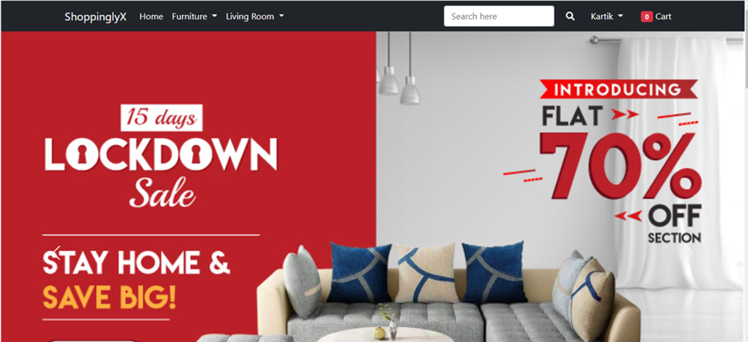

Slide 32
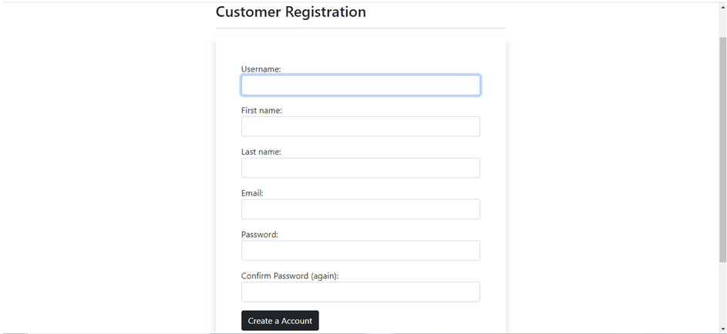

Slide 33
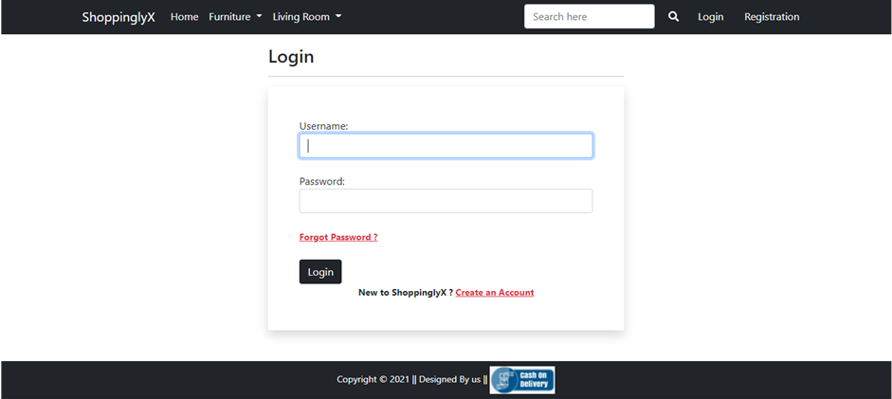

Slide 34
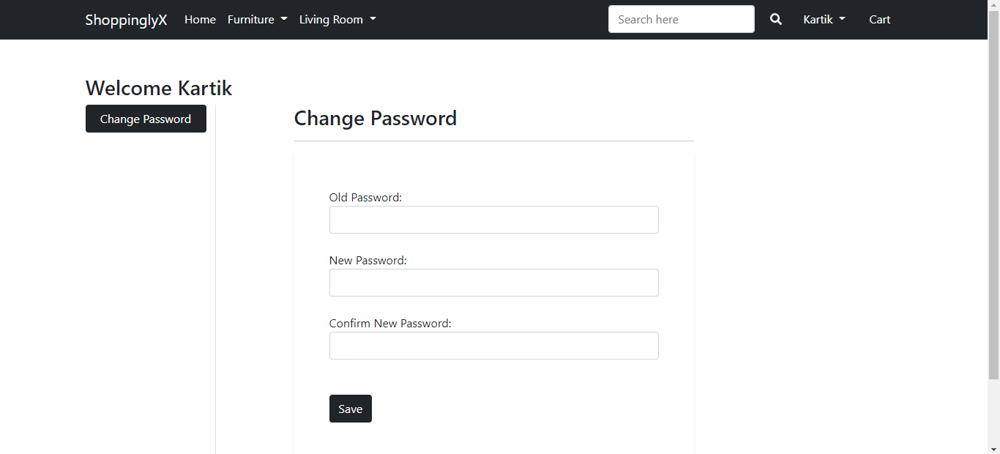

Slide 35
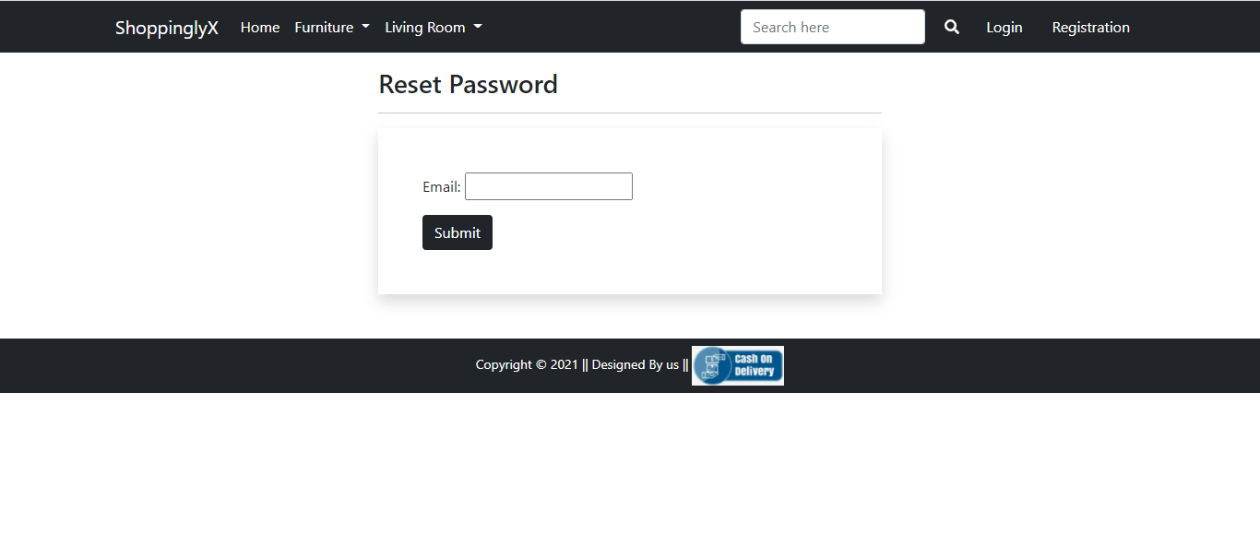

Slide 36
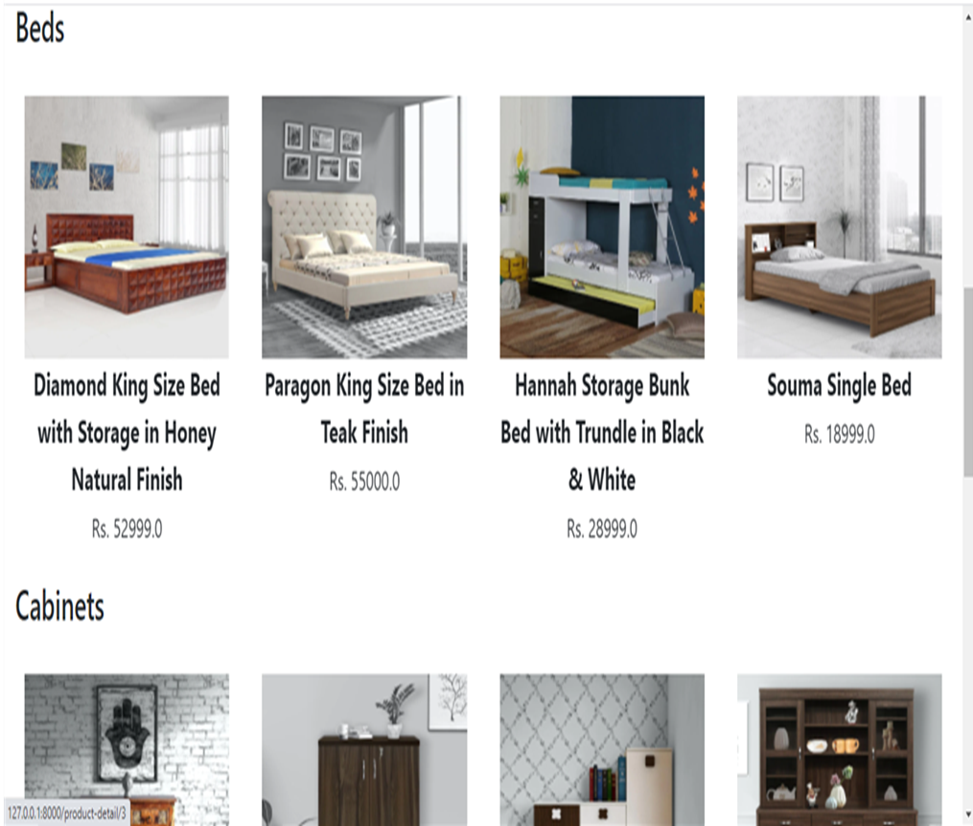

Slide 37
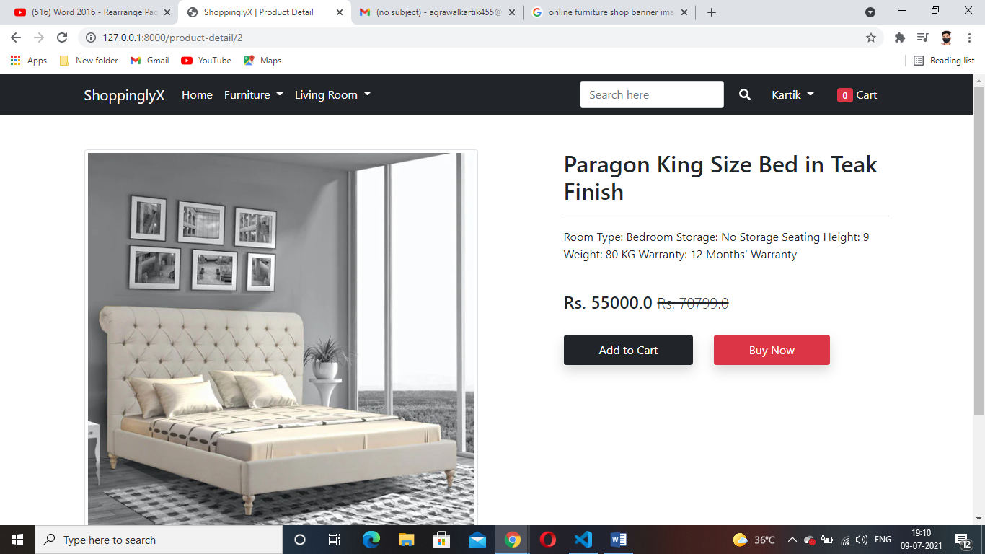

Slide 38
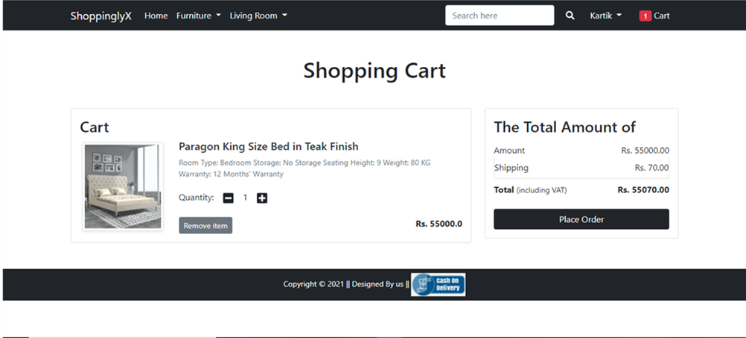

Slide 39
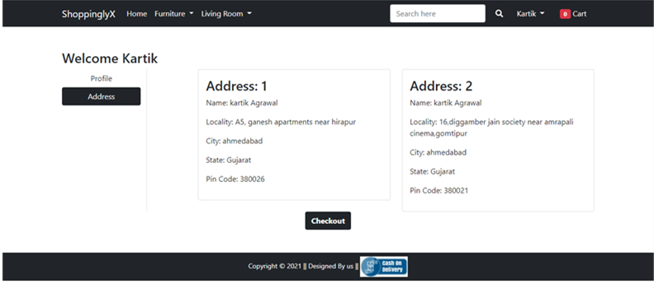

Slide 40
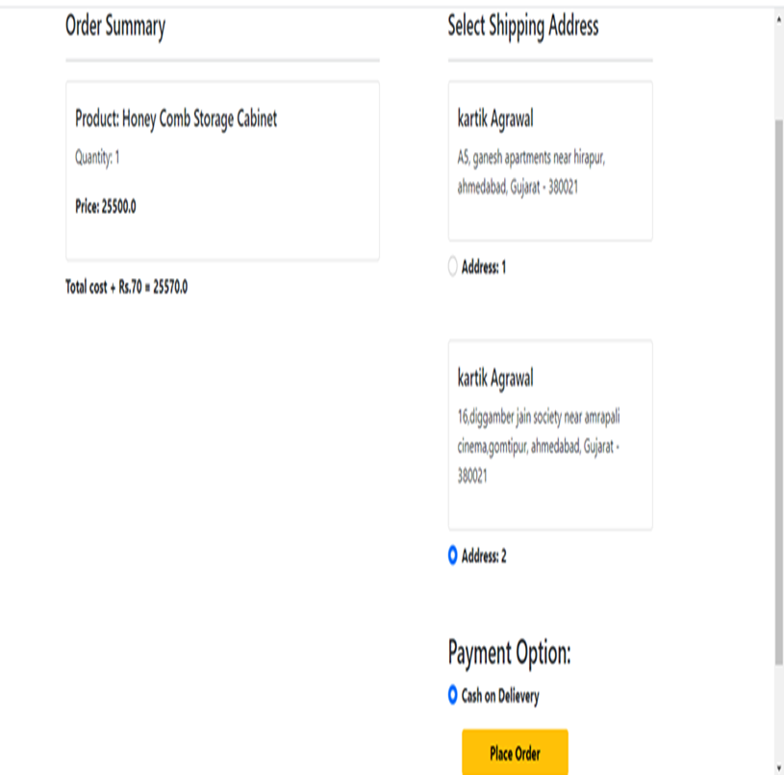

Slide 41
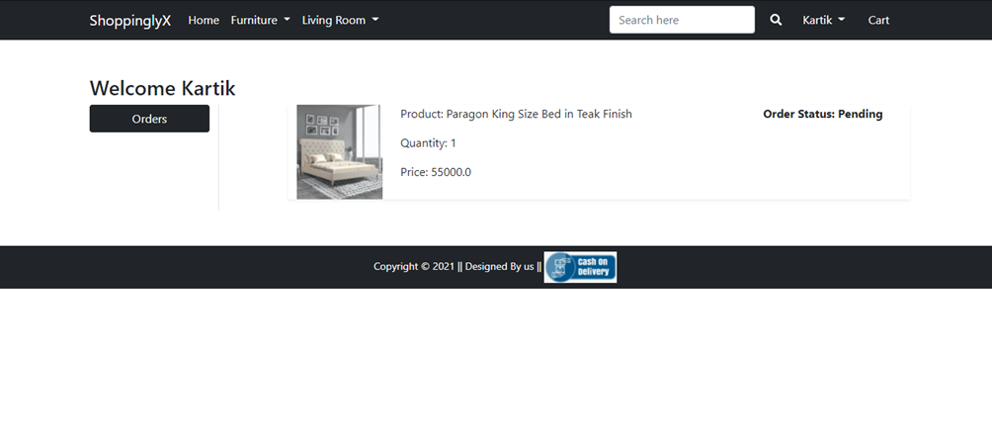

Slide 42
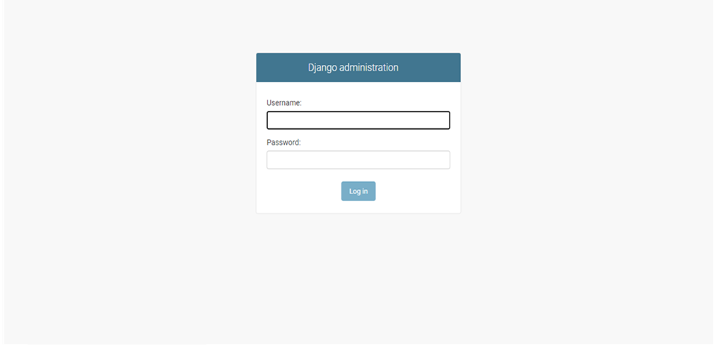

Slide 43
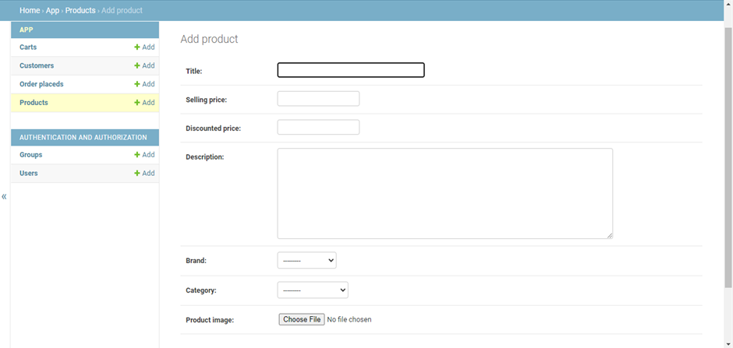

Slide 44
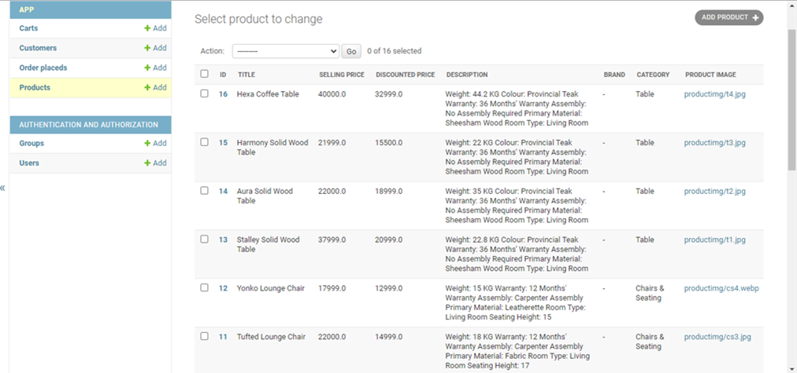

Slide 45
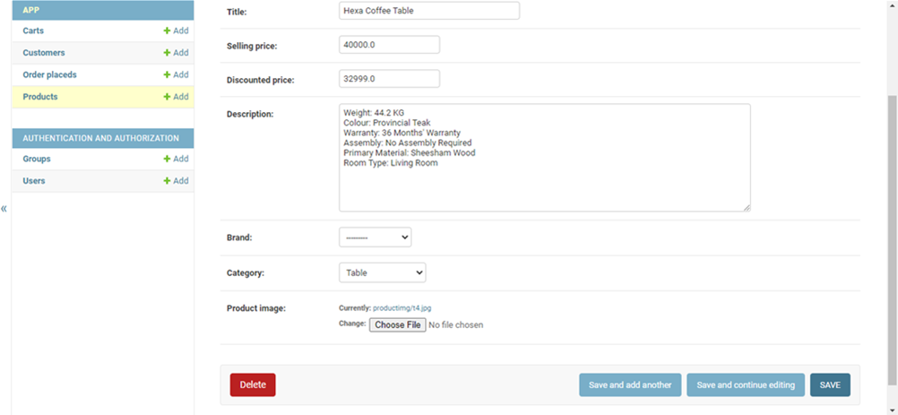

Slide 46
Proposed Enhancements
The project made here is just to ensure that this product could be valid in today real challenging world. Here all the facilities are made and tested. Currently it is not visible on virtual world (Internet) because of some limitations of project. In future it may be there.

Slide 47
Conclusion
Online shopping is the best way to purchase any item but be careful because there may be some fake products on different sites. But not to worry, on my site you will get all items genuine and trusty, just check once here before buy anywhere.

Slide 48
Bibliography
For the successful working of my project, we have referred many sources for the code snippets, logics and tips and tricks from the website.
Most I searched for the required possessions on the google.com search engine. Many of the logics in my projects are used from the free code listed on the web pages.
Web sites:
https://www.draw.io/create-new-diagram
www.stackoverflow.com
https://www.w3school.com/python-tutorial
https://docs.djangoproject.com/
https://getbootstrap.com/

Slide 49
THANK YOU

